Slide 1
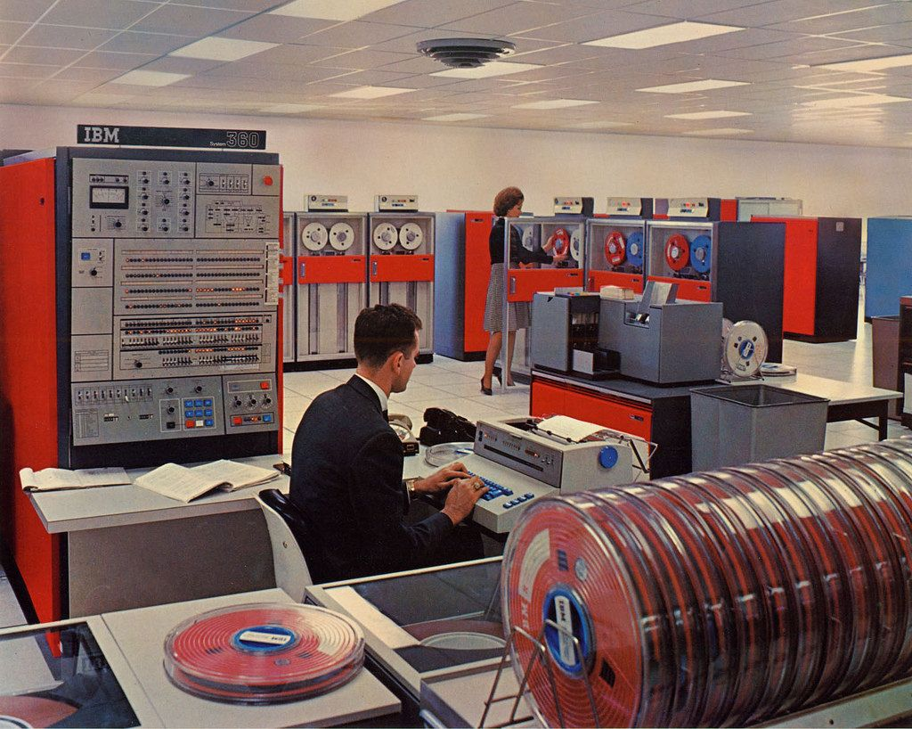
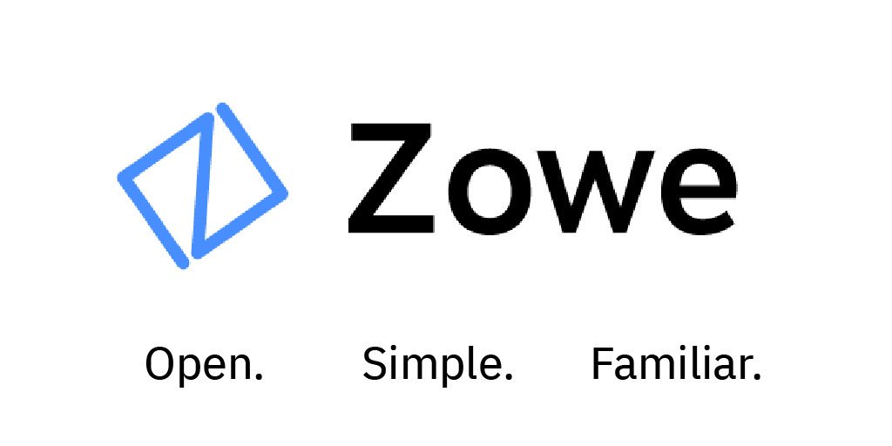

Slide 2
Mainframes are dead
Mainframes are expensive
Legacy System
Mainframe is out of the cloud
Mainframe is boring

Slide 3
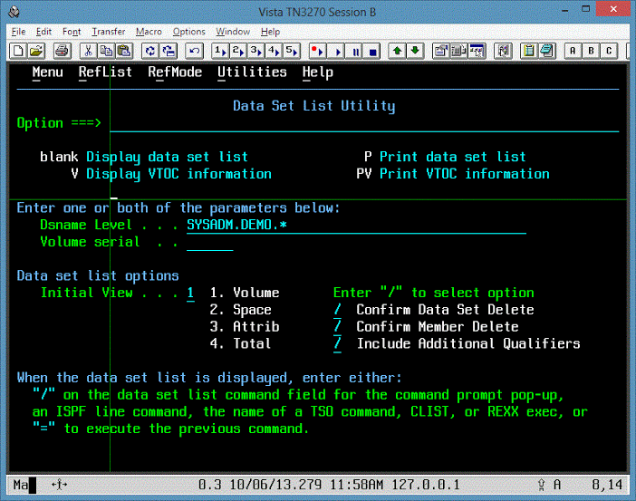

Slide 5
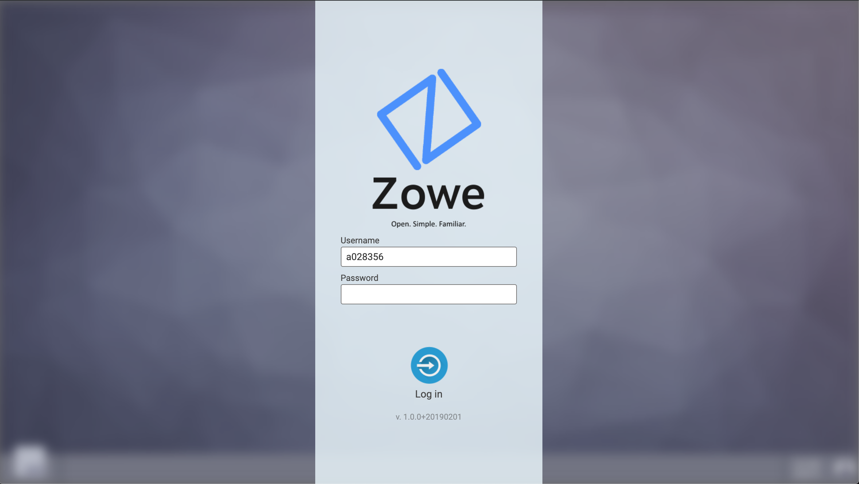
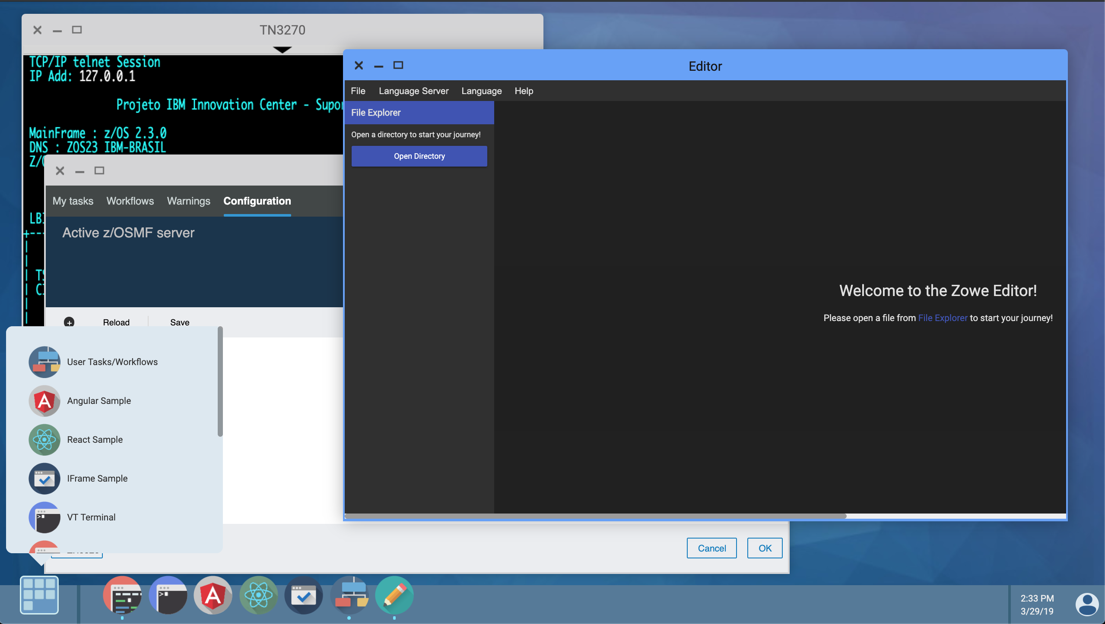

Slide 6
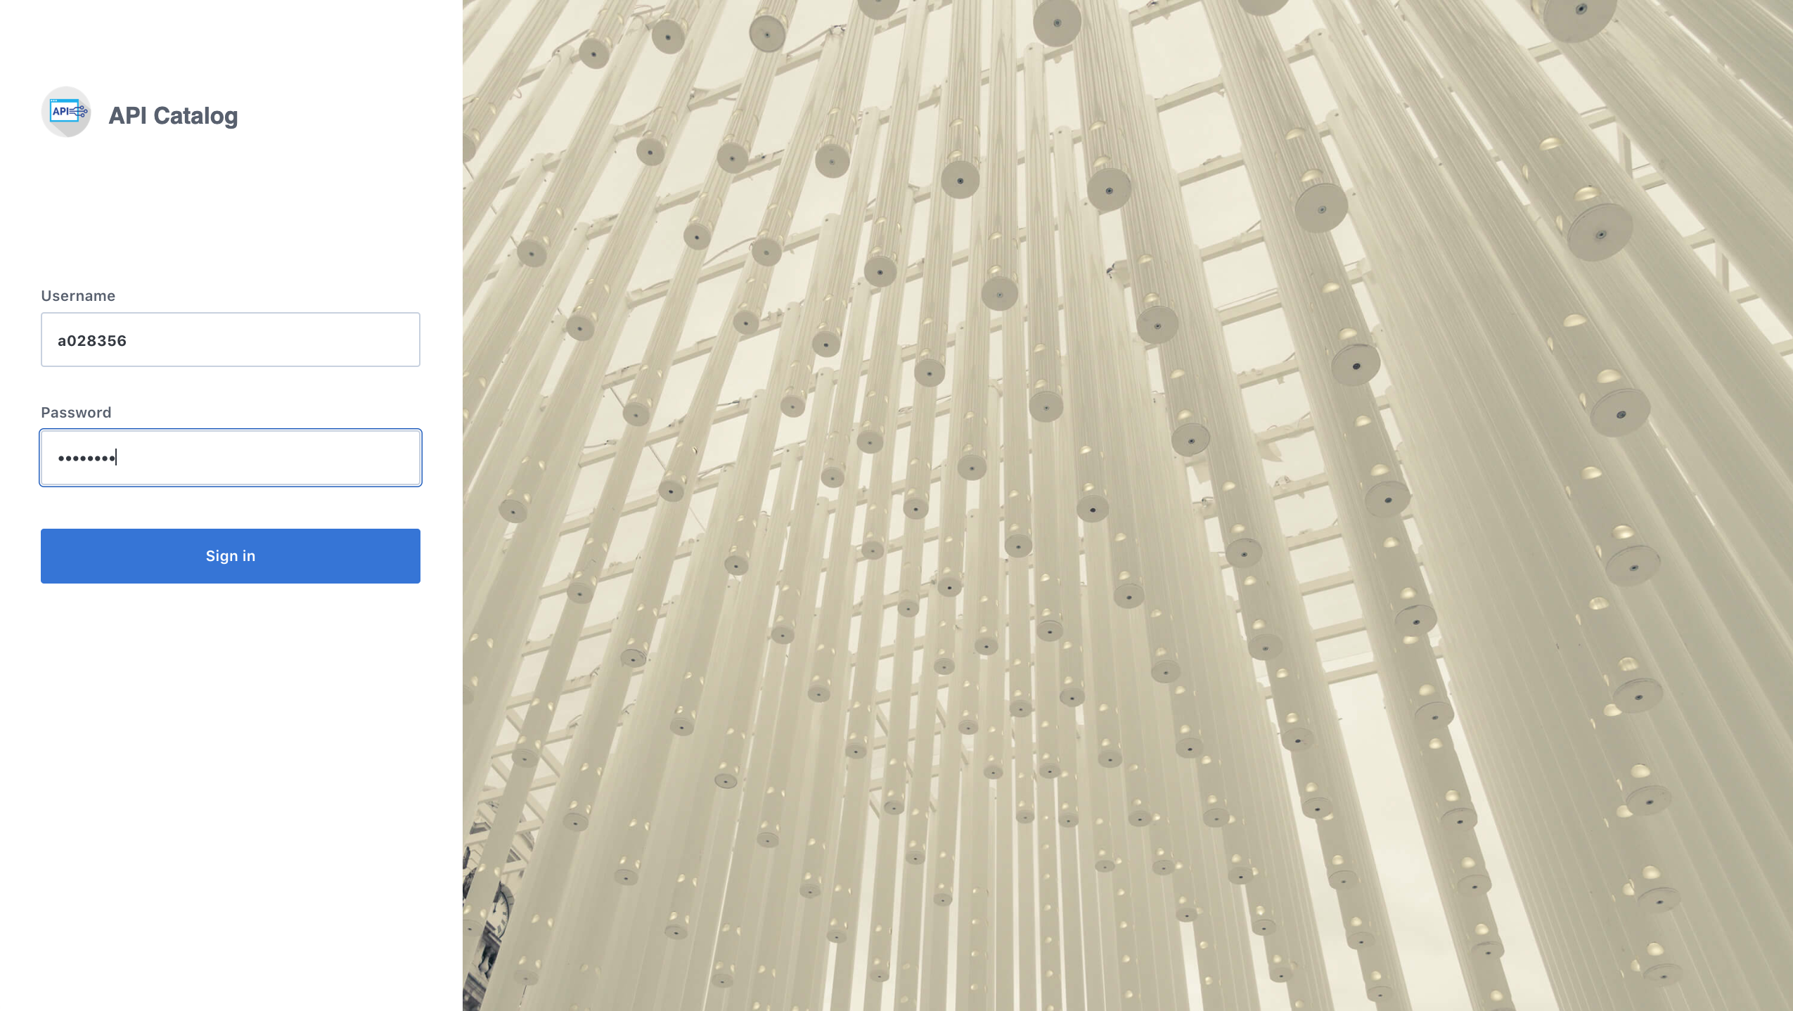

Slide 7
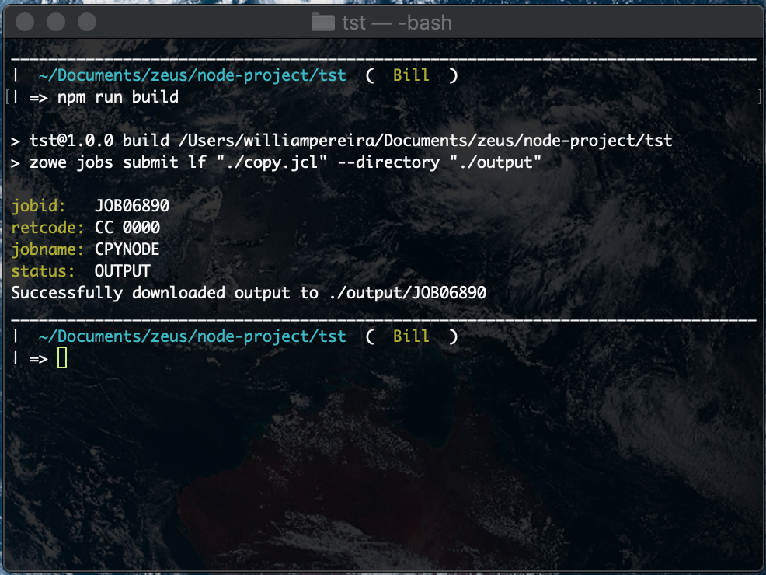
"build": "zowe jobs submit lf \"./copy.jcl\" --directory \"./output\""

Slide 8
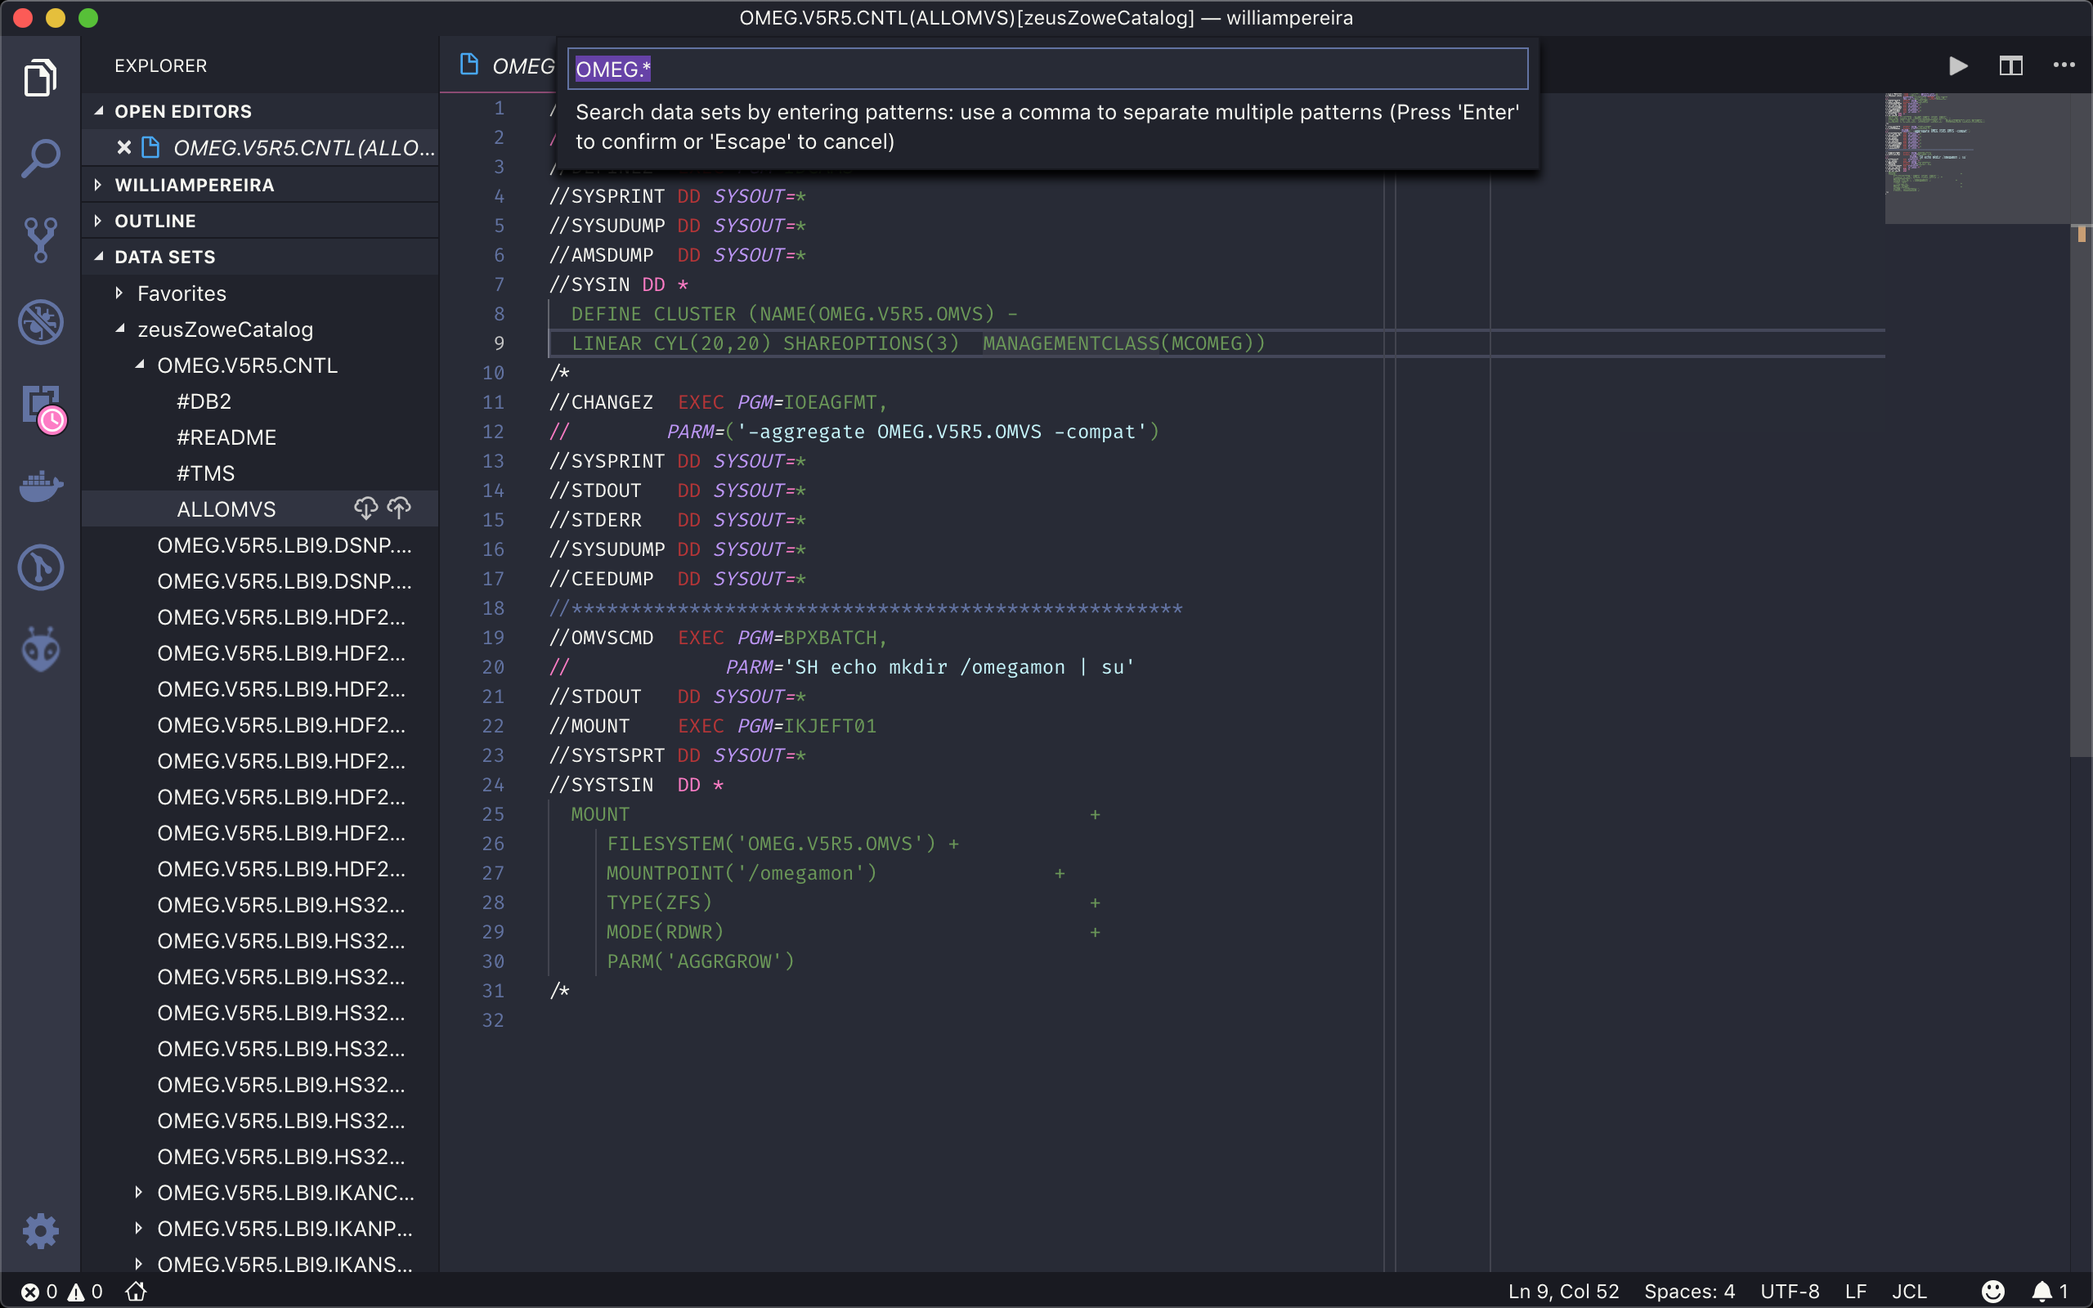
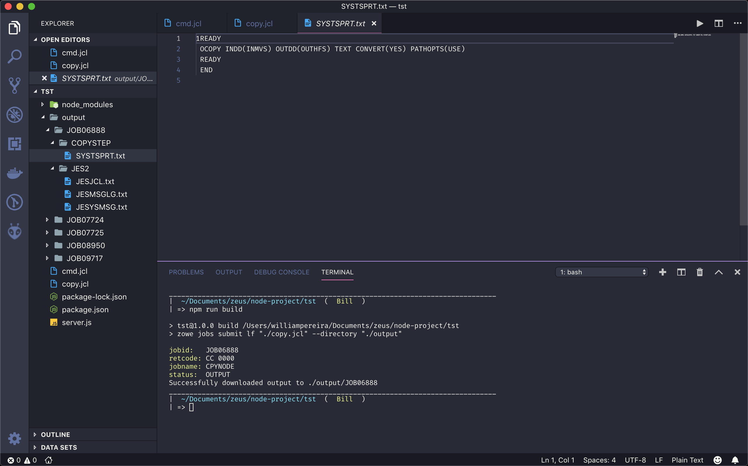

Slide 9
References
https://github.com/billpereira/zowe-cli-training
https://computerworld.com.br/2016/06/13/sete-mitos-sobre-mainframe/
https://it.toolbox.com/blogs/trevoreddolls/best-job-in-the-world-022419
https://www.openmainframeproject.org/projects/zowe
https://www.openmainframeproject.org/blog/2019/02/04/keeping-up-with-the-zowians-best-ways-to-follow-zowe-community-developments
http://ibmsystemsmag.com/mainframe/trends/whatsnew/open-source-zowe-project/
https://medium.com/@dkelosky/zowe-and-hlasm-hello-world-build-deploy-695be1eb13dc
https://medium.com/@dkelosky/how-to-automate-z-os-data-set-allocation-using-zowe-json-30e70fb960d8
https://www.youtube.com/channel/UC-WTXQQtz2m5iTflJLK59aw/videos
https://www-01.ibm.com/events/wwe/ast/mtm/zowe.nsf/enrollall?openform
https://blog.rocketsoftware.com/2013/05/think-a-mainframe-is-expensive/#.XJqeexNKgWo
https://www.brightworkresearch.com/saaseconomy/2019/01/04/how-to-understand-the-cost-advantages-of-mainframe-versus-on-premises-server/
https://www.youtube.com/watch?v=Kndb_8DhQcE
https://www.linuxfoundation.org/blog/2019/02/how-zowe-is-bringing-the-mainframe-into-the-modern-age/
https://www.youtube.com/watch?v=0XbfLBIoL0E
https://www.share.org/blog/think-millennials-don-t-want-to-work-in-mainframe?-think-again
https://devops.com/webinars/bridging-modern-devops-and-the-mainframe/?submissionGuid=4a95d1da-5037-44e7-9658-c3a920a3aeec

